Slide 1
Gather Your Groups
Get control of your Office 365 Groups

Slide 2


Slide 3
Paul Schaeflein
Technical Architect, AddIn365
Microsoft MVP, Office Development
Co-host, Microsoft 365 Developer Podcast
Developer – Speaker – Hockey fan

Slide 4
About AddIn365
Microsoft managed ISV partner.
CIO Review Top 20 Global Office 365 solution provider.
Work directly with Office 365 Product Group to help design Office 365.
Focused on delivering value to large commercial businesses.
Products have been KPMG PEN tested.

Slide 5
Agenda
Group Creation
Group Management (Governance)
Expiration

Slide 6
Group Creation

Slide 7
Group Creation
Three models:
Open (default)
IT-led
Controlled

Slide 8
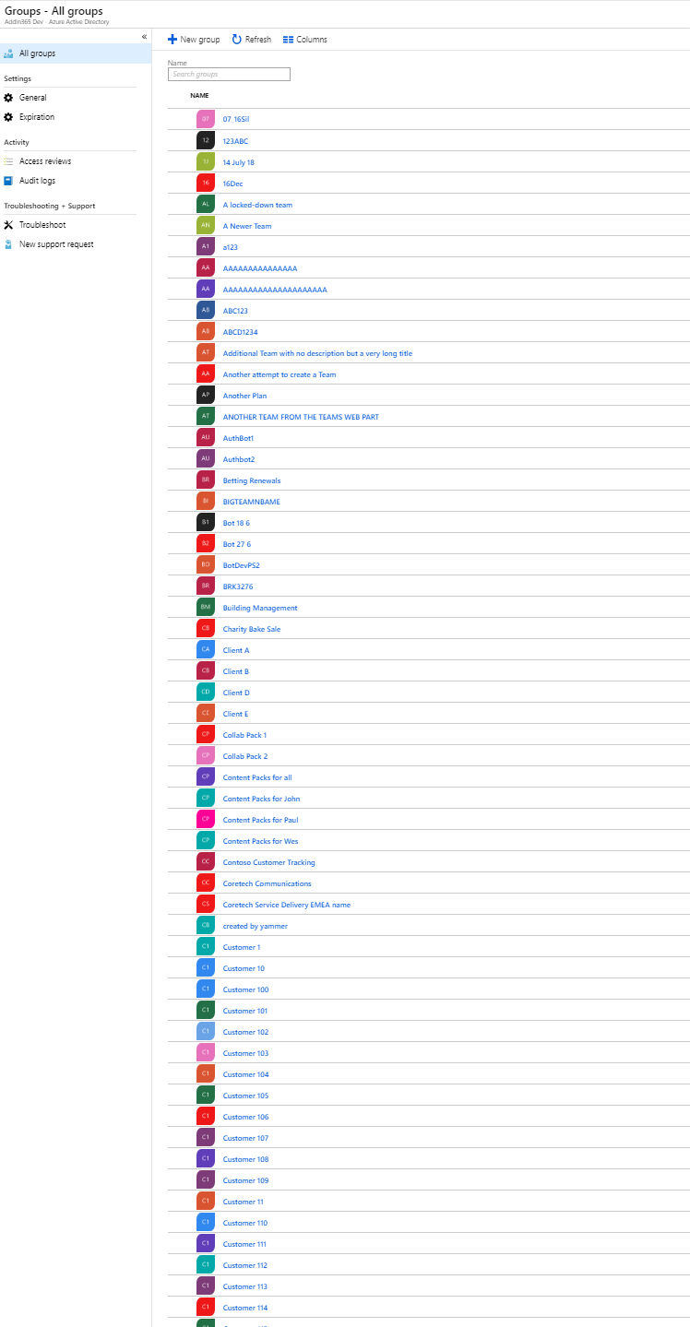
Group Creation – “Open Model”
Groups are created in various workloads:
Outlook Desktop / Web / Mobile
SharePoint
Planner
Power BI
Teams
Yammer

Slide 9
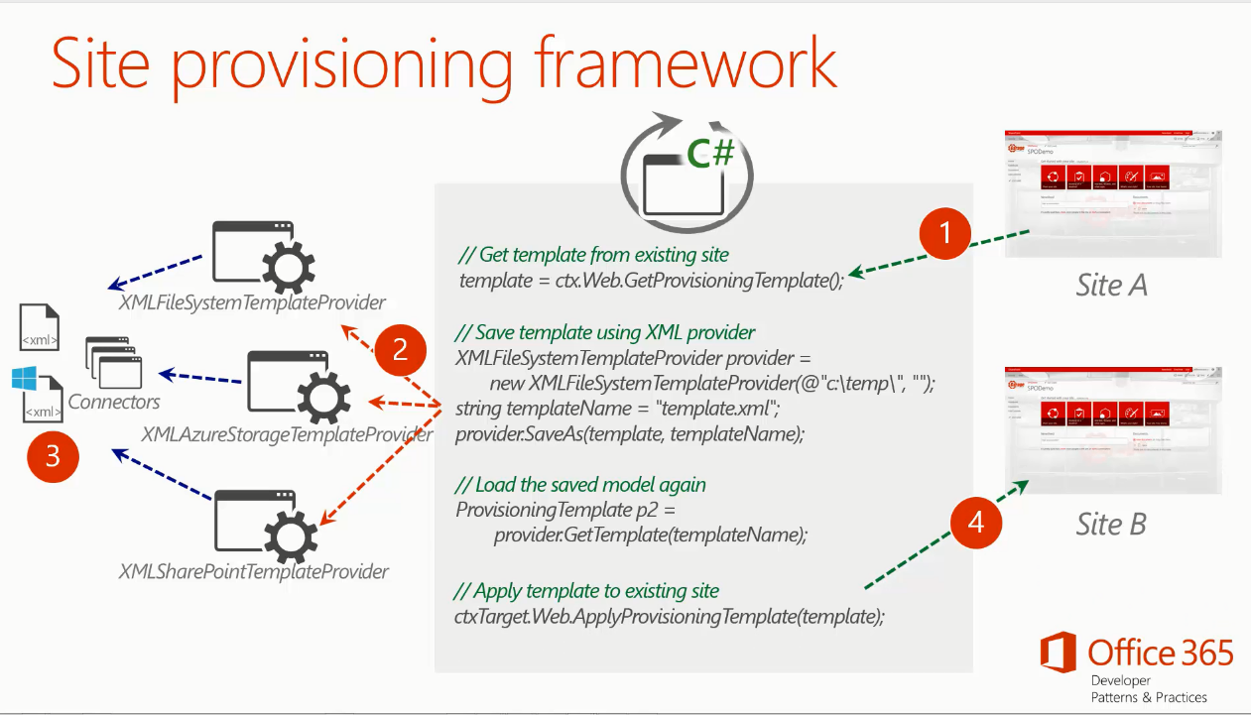
Group Creation – Controlled
DIY
Community Tools
Third-party Solutions

Slide 10
Group Creation Guidance
What is the purpose/focus?
Mail/Calendar
Company-wide comms
Chat-based collab
Who is in group
Single department
Cross-department (v-team)
External Users
Balance Users/IT
Naming / Expiration policies

Slide 11
Group Creation Guidance
Creation Permission
Designate a group that can create groups
Naming policy
Force a naming convention
Prefix / Suffix
Fixed strings or certain AAD attributes
Blocked Words
IT Admin override

Slide 12
Demo
Group Creation policies
Group Naming policies

Slide 13
Group Management

Slide 14
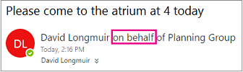
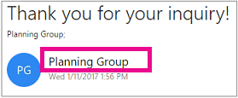
Group Management
Allow members to send as or send on behalf of a Group

Slide 15
Group Management
Retention Policies
Labels
In-Place Legal Holds
Preservation policies
O365 Security & Compliance searches

Slide 16
Demo
Classifications
Usage Guidelines
Guest access controls

Slide 17
Group Expiration / End of Life

Slide 18
Expiration Policy
Set expiration timeline
Notification intervals are autoset
Set fallback email address for ownerless groups
Apply the policy to selective groups

Slide 19
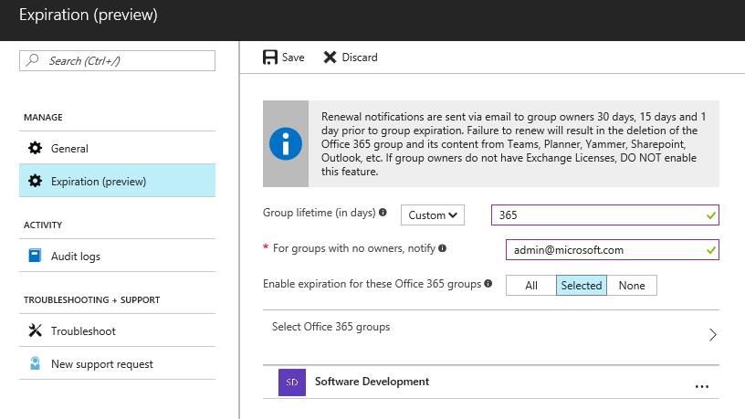
Expiration Policy

Slide 20
Resources
https://scon.link/gather-groups

